Slide 1
Java (SpringBoot and React Project) Enterprise Ecommerce Application BRD
The Online Shopping is the process whereby consumers directly buy goods and services without any intermediary service over the internet. The goal of this website is to develop a web-based interface for eCommerce website, the website would be easy to use and hence the shopping experience pleasant for the users.
The main goal of this website is:
To develop an easy to use web-based interface where customers can search for products, view a complete description of the product and order the product.
Reach out to a larger audience - internet access is becoming so mainstream now that your product/service can reach almost everyone on the planet with an internet-enabled device.
Your virtual shop remains open and operational 24x7 even if you/your employee are not working- this might not be wholly true if your product is a service-which requires immediate human-intervention.

Slide 2
Functional Requirement
Registration: - A new user will have to register in the system by providing essential details in order to view the products in the system. The admin must accept a new user by unblocking him.
Login: - A user must login with his user name and password to the system after registration.
Add Products :The shopping cart project contains different kind of products. The products can be classified into different categories by name. Admin can add new products into the existing system with all its details including an image.
View Products: - User can view the list of products based on their names after successful login. A detailed description of a particular product with product name, products details, product image, price can be viewed by users.
Delete Products: - Administrator can delete the products based on the stock of that particular product.
Search products: - Admin will have a list view of all the existing products. He can also search for a particular product by name.
View Order: - Administrator can view the Orders which is generated by the users. He can verify the details of the purchase.
Delete Order: - Admin can delete order from the orders list when the product is taken for delivery. Add to cart: - The user can add the desired product into his cart by clicking add to cart option on the product. He can view his cart by clicking on the cart button. All products added by cart can be viewed.

Slide 3
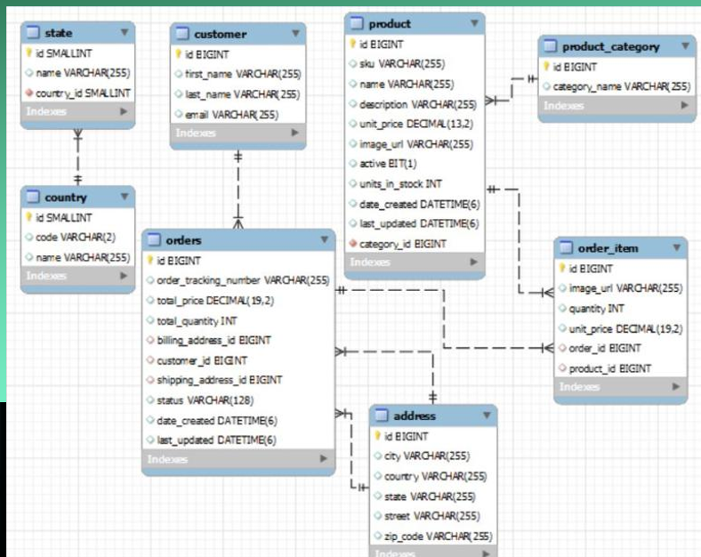
ERD

Slide 4
List of Responsibilities
Show a list of products
Add products to a shopping cart (CRUD)
Shopping cart checkout
User login/logout security
Track user orders for logged in users

Slide 5
List of Technologies to be used
SpringBoot as a Back End
React as Front End
Maven
MySQL DB
Deployment to Azure
Stripe Payment Gateway
OAuth2.0 Okta Authentication and Authorization.

Slide 6
Deployment to Azure
GitHub Actions- CI CD
SonarClould for Static Code Analyser
Jacoco – for code coverage
Azure App Insight for Logging

